Slide 1
Working Capital Policy

Slide 2
Introduction
The key difference between long term financial management and working capital management is in terms of the timing of cash. While long term financial decisions like buying capital equipment or issuing debentures involve cash flows over an extended period of time(5 to 15 years or even more), short term financial decisions typically involve cash flows within a year or within the operating cycle of the firm

Slide 3
Working capital management is a significant facet of financial management. Its importance stems from two reasons:
1.Investment in current assets represents a substantial portion of total investment.
2.Investment in current assets and the level of current liabilities have to be geared quickly to changes in sales.

Slide 4
Arranging short term financing, negotiating favorable credit terms, controlling the movement of cash, administering accounts receivables, and monitoring the investment in inventories consume a great deal of time of financial managers

Slide 5
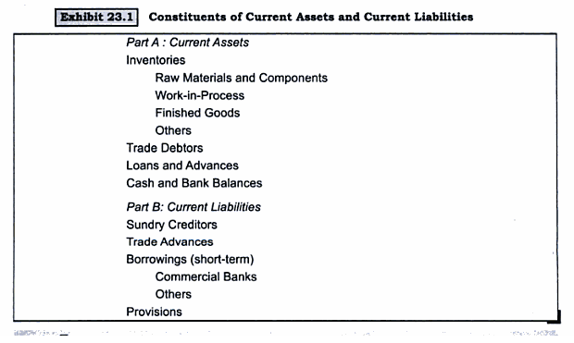
Characteristics of current Assets

Slide 6
Characteristics of current Assets
While managing working capital, bear in mind two characteristics of current assets
i) Short life span ii) Swift transformation into other asset forms.
Current assets have a short term life span. Cash balances may be held idle for a week or two. Accounts receivables may have a life span of 30 to 60 days, and Inventories may be held for 1 to 60 days.

Slide 7
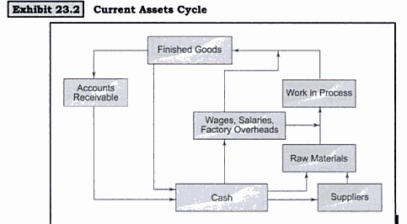
Characteristics of current Assets

Slide 8
Factors Influencing Working Capital Requirements
The working capital needs of a firm are influenced by numerous factors. The important ones are.
1) Nature of business
2) Seasonality of operations
3) Production policy
4) Market conditions
5) Conditions of supply

Slide 9
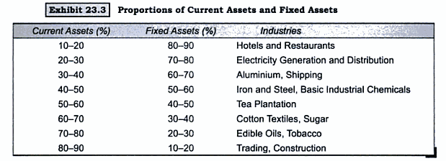
Factors Influencing Working Capital Requirements

Slide 10
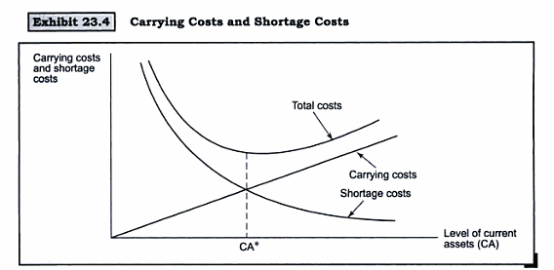
Level of Current Assets

Slide 11
Level of Current Assets
Flexible Policy ( also referred to as a conservative policy)- The investment in current assets is high. This means that the firm maintains a huge balance of cash and marketable securities, carries large amounts of inventories, and grants generous terms of credit to customers, which lead to a high level of Debtors

Slide 12
Level of Current Assets
Restrictive Policy ( Aggressive Policy), the investment in the current assets is low. This means that the firm keeps a small balance of cash and marketable securities, manages with small amounts of inventories and offers stiff terms of credit which leads to low level of debtors

Slide 13
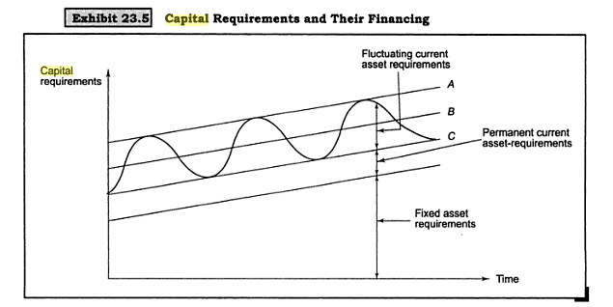
Current Assets Financing Policy

Slide 14
Current Assets Financing Policy
What mix of long term capital and short term debt should the firm employ to support its current assets?
Exhibit depicts how total assets and hence the capital requirements change over time for a growing firm.
Fixed assets are assumed to grow at a constant rate which reflects the secular rate of growth in sales.
Current assets, too are expected to display the same long term growth; however they exhibit substantial variation around the trend line

Slide 15
Current Assets Financing Policy
Several strategies are available to a firm for financing its capita requirements.
Strategy A- Long term financing is used to meet fixed asset requirements as well as peak working capital requirements. When the working capital requirement is less than its peak level, the surplus is invested in liquid assets( Cash and marketable securites)

Slide 16
Current Assets Financing Policy
Strategy B : Long term financing is used to meet fixed asset requirements, permanent working capital requirements, and a portion of fluctuating working capital requirements.
During seasonal upswings, short term financing is used; during seasonal downswings, surplus is invested in liquid assets.

Slide 17
Current Assets Financing Policy
Strategy C: Long term financing is used to meet fixed asset requirements and permanent working capital requirements. Short term financing is used to meet fluctuating working capital requirements.

Slide 18
The Matching Principle
According to this principle, the maturity of the sources of financing should match the maturity of the assets being financed.
This means that the fixed assets and permanent current assets should be supported by long term sources of finance, whereas fluctuating current assets must be supported by short term sources of finance

Slide 19
Operating Cycle And Cash Cycle
The investment in working capital is influenced by the following events in the operating cycle of the firm:
Purchase of Raw materials
Payment for raw materials
Manufacture of goods
Sale of finished goods
Collection of cash for sales

Slide 20
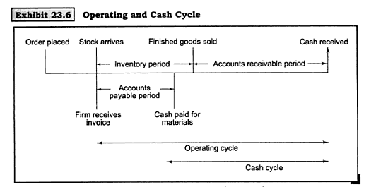
Operating Cycle And Cash Cycle

Slide 21
Operating Cycle And Cash Cycle
The time lag between the purchase of raw materials and the sale of finished goods is the Inventory Period.
Customers pay their bills some time after the sales. The period that elapses between the date of sales and the date of the collection of receivables is the accounts payable period ( Debt Period)

Slide 22
Operating Cycle And Cash Cycle
The time that elapses between the purchase of raw materials and collection of cash for sales is referred to as the operating cycle,
Whereas the time length between the payment for raw material purchases and the collection of cash for sales is referred to as the cash cycle.
The operating cycle is the sum of inventory period and the accounts receivable period, whereas the cash cycle is equal to the operating cycle less the accounts payable period

Slide 23
Operating Cycle And Cash Cycle

Slide 24
 | Profit & Loss Account data |  | Balance sheet data
Sales | 800 |  | Beg of 1910 | End of 1910
Cost of Goods Sold | 720 | Inventory | 96 | 102
 |  | Accounts receivable | 86 | 90
 |  | Accounts Payable | 56 | 60
Exhibit provides the relevant information for Horizon Limited. Based on this
Information, we calculate several things

Slide 26
Cash Requirement For Working Capital
As a financial manager you will be interested in figuring out how much cash you should arrange to meet the working capital needs of your firm.

Slide 27
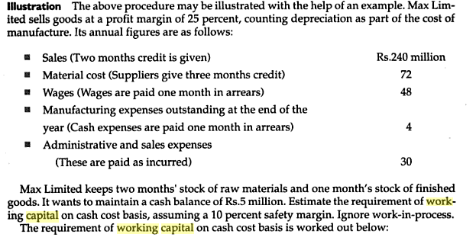

Slide 28
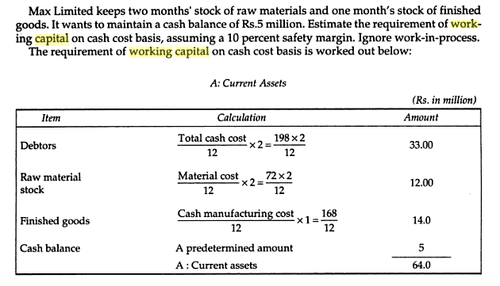

Slide 29
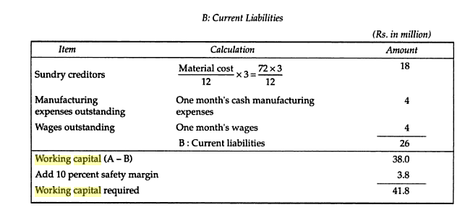

Slide 30
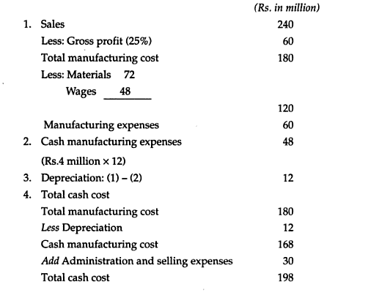

Slide 31
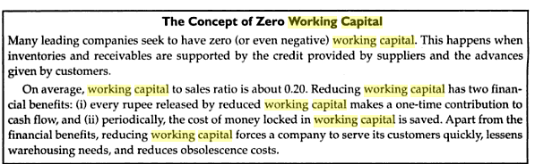

Slide 32
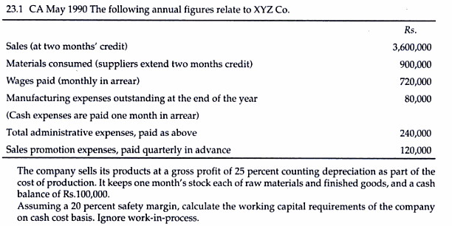

Slide 33
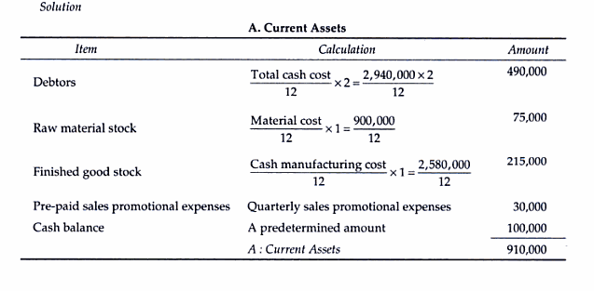

Slide 34
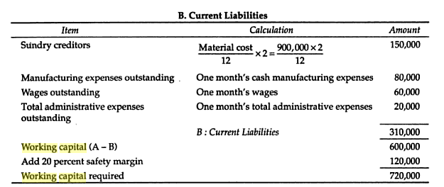

Slide 35
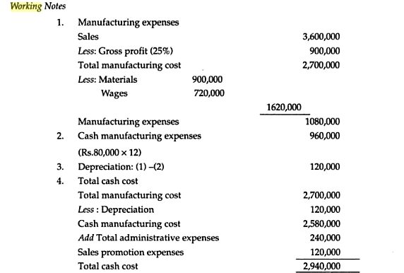

Slide 36
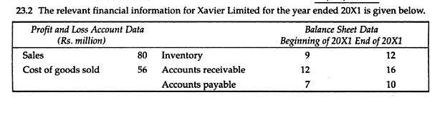
WHAT IS THE LENGTH OF THE OPERATING CYCLE? THE CASH CYCLE? ASSUME 365
DAYS TO A YEAR

Slide 37
PROB: THE RELEVANT INFORMATION FOR ZENITH LIMITED IS GIVEN BELOW
 | Profit & Loss Account data |  | Balance sheet data
Sales | 500 |  | Beg of 1910 | End of 1910
Cost of Goods Sold | 360 | Inventory | 60 | 64
 |  | Accounts receivable | 80 | 88
 |  | Accounts Payable | 40 | 46
WHAT IS THE LENGTH OF THE OPERATING CYCLE?THE CASH CYCLE

Slide 38
PROB: THE RELEVANT INFORMATION FOR APEX LIMITED IS GIVEN BELOW
 | Profit & Loss Account data |  | Balance sheet data
Sales | 1000 |  | Beg of 1910 | End of 1910
Cost of Goods Sold | 750 | Inventory | 110 | 120
 |  | Accounts receivable | 140 | 150
 |  | Accounts Payable | 60 | 66
WHAT IS THE LENGTH OF THE OPERATING CYCLE?THE CASH CYCLE

Slide 39
THE FOLLOWING ANNUAL FIGURES RELATED TO XYZ CO.
Sales ( at two months credit) | 7200,000
Materials consumed ( Suppliers extend two months credit) | 1800,000
Wages paid ( monthly in arrear) | 1440,000
Manufacturing Expenses outstanding at the end of the year | 160,000
Total Administrative expenses paid as incurred | 480,000
Sales promotion expenses, paid quarterly in advance | 240,000
THE COMPANY SELLS ITS PRODUCTS ON GROSS PROFIT OF 25 PERCENT COUNTING
DEPRECIATION AS A PART OF THE COST OF PRODUCTION. IT KEEPS ONE MONTHS STOCK
OF RAW MATERIALS AND FINISHED GOODS AND A CASH BALANCE OF Rs 200,000
ASSUMIN A 20 % SAFETY MARGIN, WORK OUT WORKING CAPITAL REQUIREMENTS OF THE
COMPANY ON CASH COST BASIS.

